Slide 1

Predicting Depression via Social Media

Slide 2

Group Members GROUP NO.23
Group Mentor – Mr. Anil Kumar Dudyala
Anurag Kumar 1906040
Nikhil Vinay 1906041
Naseer Alam 1906043

Slide 3
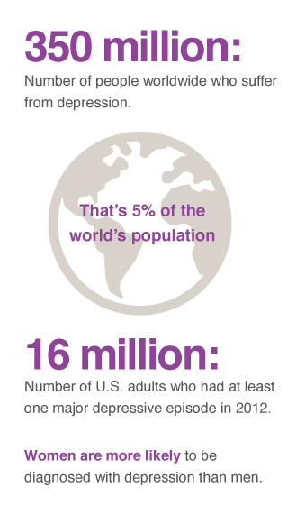
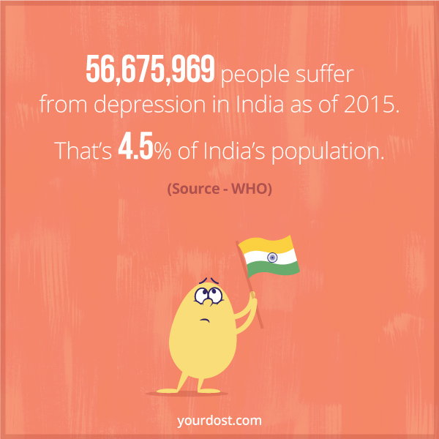
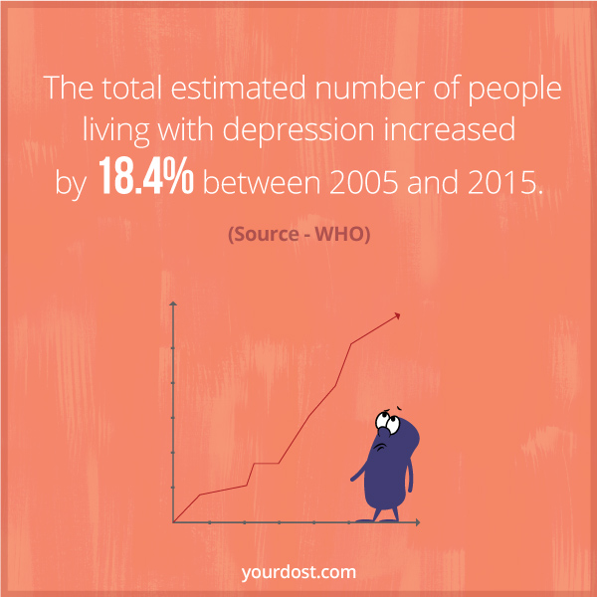
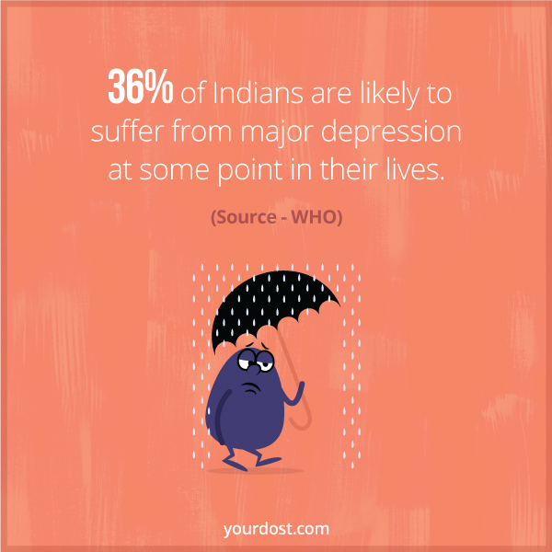
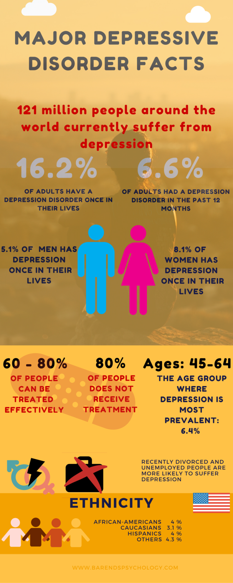
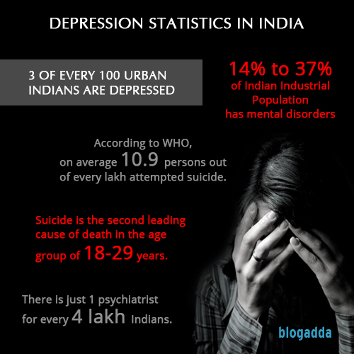
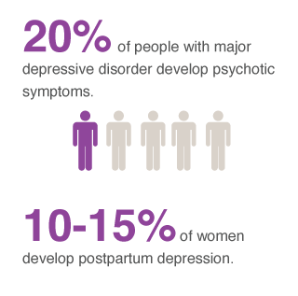

Slide 4
What is MDD and Why do we need to detect it?
Major depressive disorder – Significant Mental Health problems which disrupts Mood and Adversely Effects its psychological & occupational functioning.
Symptoms
Reduced Throughput or Work Efficiency
Insufficient Existing Services

Slide 5
Traditional Ways of Detecting Depression
Surveys : Most Efficient and reliable method
Questionnaire by Researchers:
Major Depression Inventory (MDI)
Zung Self-Rating Depression Scale(SRS)
Beck Depression Inventory (BDI)
Center for Epidemiologic Studies Depression Scale (CES-D)
Patient Health Questionnaire (PHQ-9)
Methods not efficient if used individually.
Often used in a different permutation and combination.
For larger groups can methods be applied via employment of Crowd-Sourcing.

Slide 6

Why Social Media?
Exponential Increase in Social Media.
Credibility of Popularity goes to
Uncomplicated usage
Simple availability
Ease-of-Access
Social Media as a tool
Access to a larger part of populace
Cost-effective measure

Slide 7

System architecture.
Web Application user interface
Twitter API
Text Transformation
Classification
Model
Dataset

Slide 8
Dataset/Input:
Dataset Taken from Kaggle tweets.csv
Tweets Taken from twitter API.
Manual Input from user at GUI.
Classification Models
MultinomialNaiveBayes Classifiers
logistic Regression
DecisionTree Classifier
RandomForest Classifier
Support Vector Machine(SVM)

Slide 9
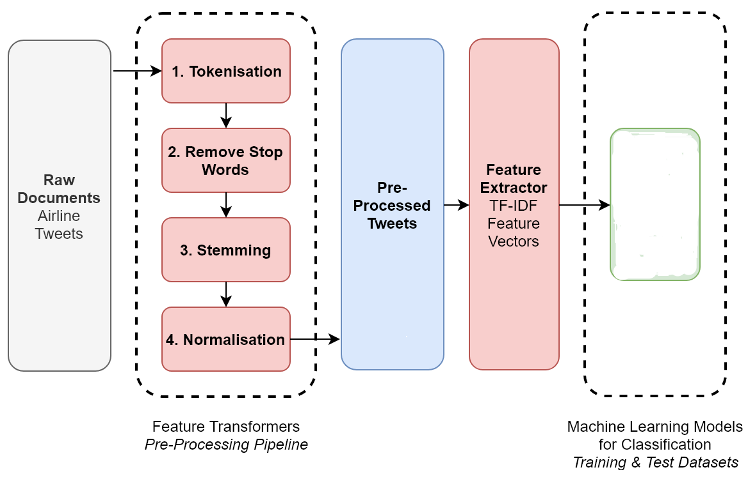
Work Flow…
NLP PIPELINE
Support Vector machine

Slide 10
Work Flow…
Feature Extraction:
1.CountVectorizer
2.TfidfVectorizer

Slide 11
Outcome
CountVectorizer
Model | Accuracy | Precision | Recall | F1 Score
MultinomialNaiveBayesClassifiers | 0.828276 | 0.776119 | 0.817610 | 0.796325
logistic Regression | 0.844416 | 0.811024 | 0.809748 | 0.810386
DecisionTreeClassifier | 0.719819 | 0.621687 | 0.811321 | 0.703956
RandomForestClassifier | 0.777276 | 0.688228 | 0.836478 | 0.755445
Support Vector Machine(SVM) | 0.835378 | 0.765690 | 0.863208 | 0.811530

Slide 12
Outcome
(CountVectorizer + TfidfTransformer)
Model | Accuracy | Precision | Recall | F1 Score
MultinomialNaiveBayesClassifiers | 0.850872 | 0.857143 | 0.764151 | 0.807980
logistic Regression | 0.832795 | 0.861804 | 0.705975 | 0.776145
DecisionTreeClassifier | 0.769529 | 0.682353 | 0.820755 | 0.745182
RandomForestClassifier | 0.827631 | 0.763948 | 0.839623 | 0.800000
Support Vector Machine(SVM) | 0.852808 | 0.844595 | 0.786164 | 0.814332

Slide 13
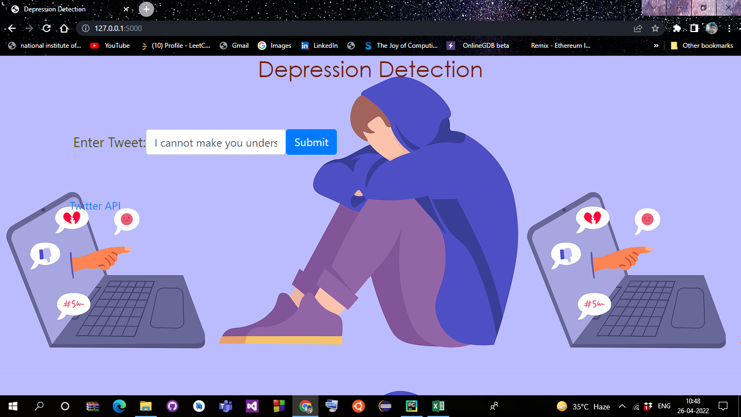
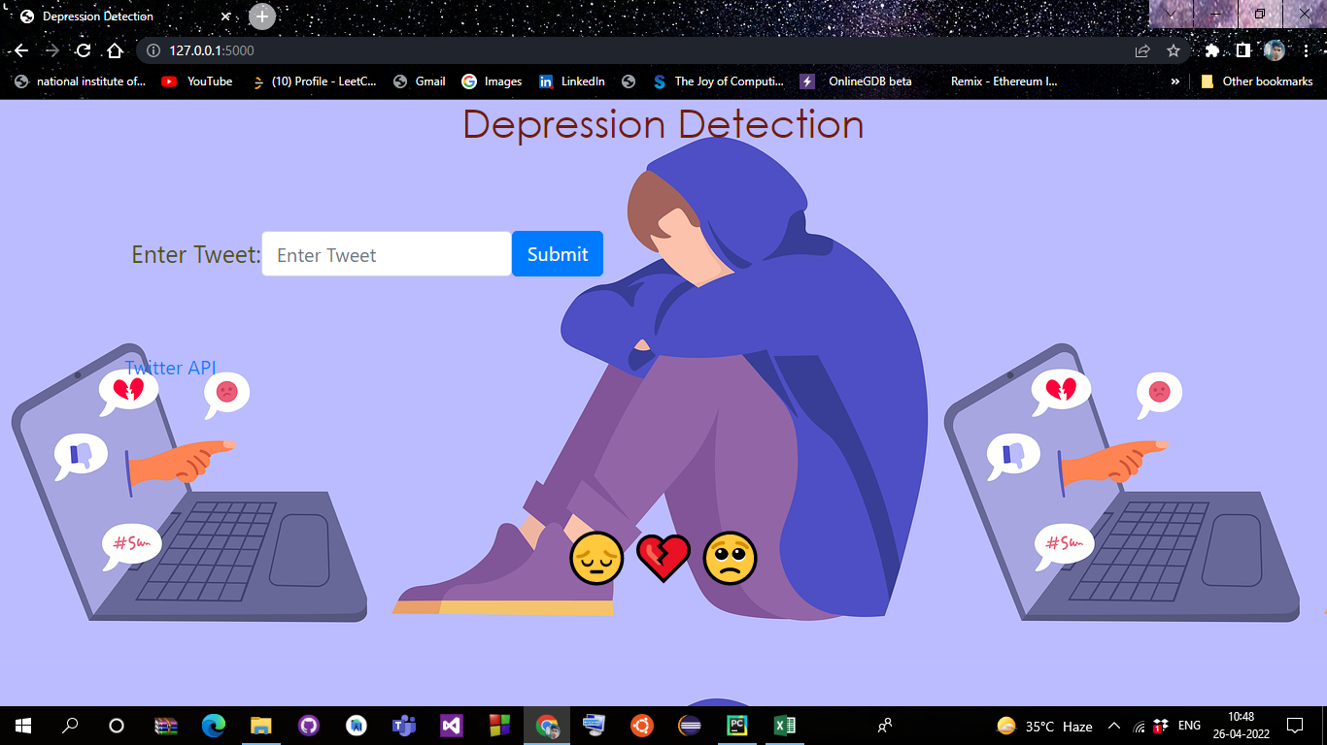
USER Interface
USER INPUT
Output

Slide 14
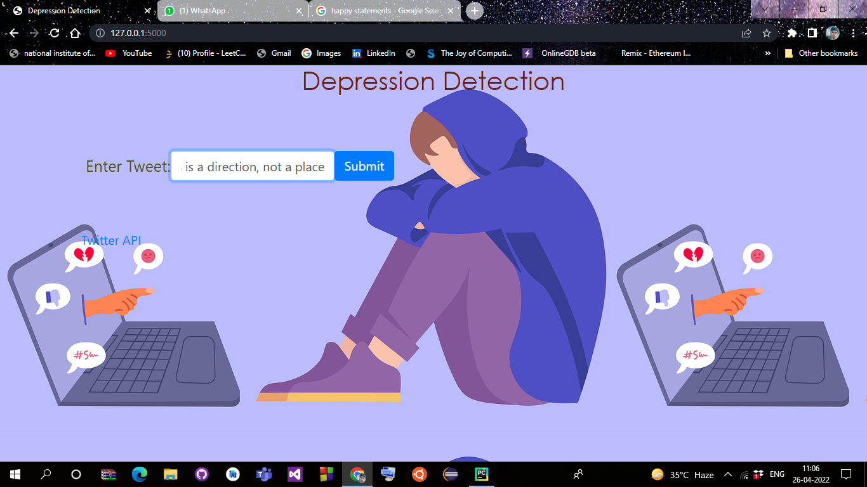
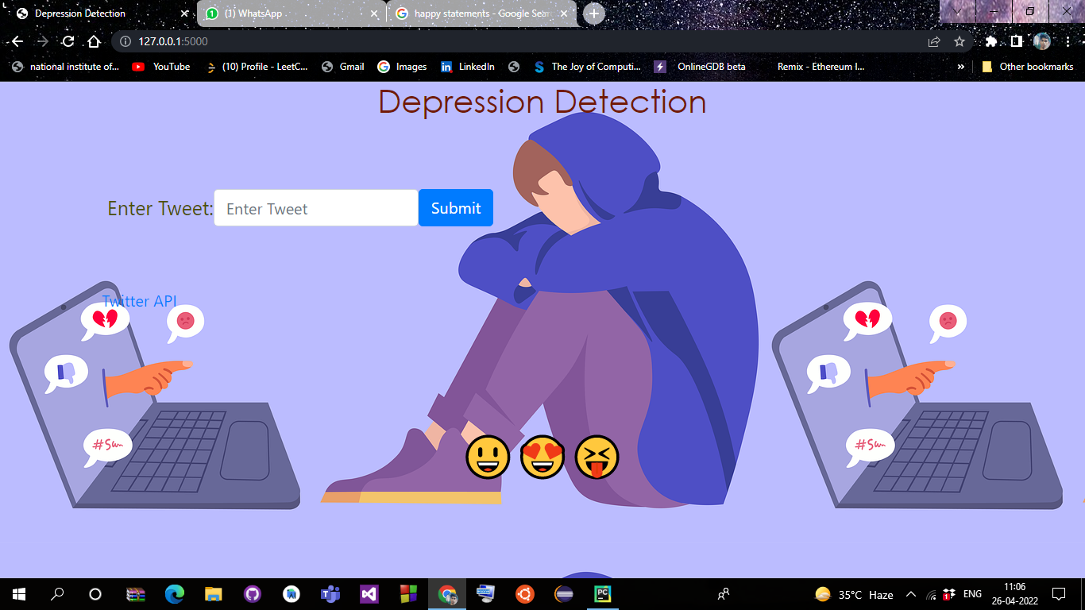
USER INPUT
Output

Slide 15
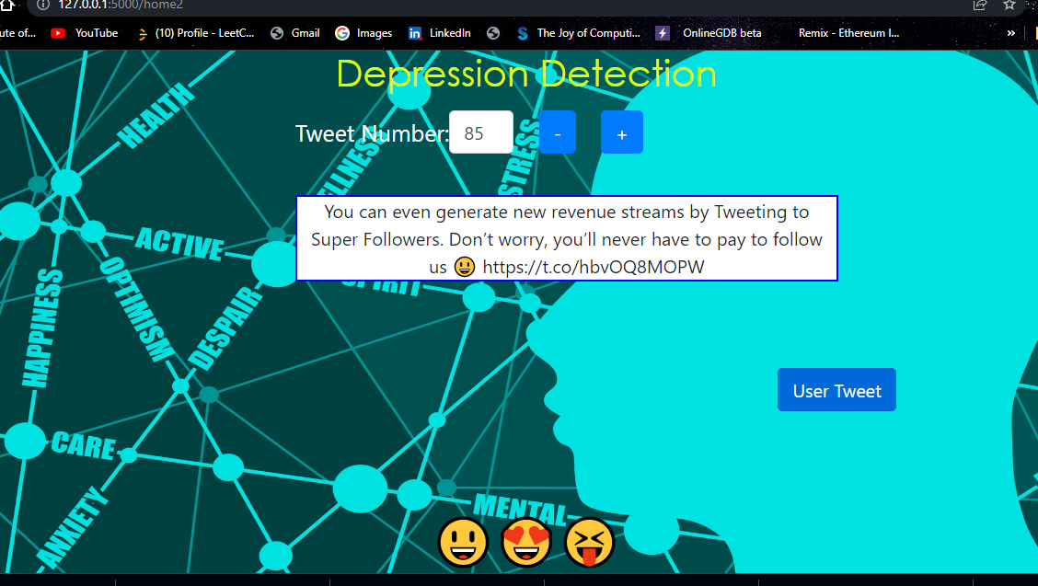
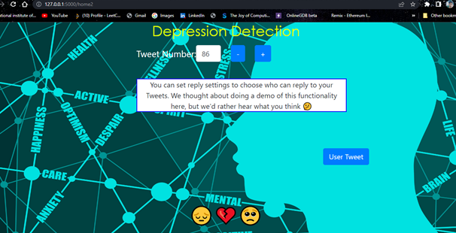
INPUT FROM Twitter API
Output

Slide 16
References
[1] https://yourdost.com/
[2] https://www.who.int/news-room/fact-sheets/detail/depression
[3] https://indianhealthorganization.wordpress.com/30-2/
[4] https://www.oreilly.com/library/view/machine-learning-with/9781789346565/assets/e322457d-6d42-4f82-999a-a2a446d5862e.png
[5] Depression-Dataset Analysis and Machine Learning | Kaggle
[6] Scikit-Learn. https://scikit-learn.org
[8] Cavazos-Rehg, P. A., Krauss, M. J., Sowles, S., Connolly, S., Rosas, C., Bharadwaj, M., and Bierut, L. J. 2016. A content analysis of depression-related tweets. Computers in Human Behavior. https://doi.org/10.1016/j.chb.2015.08.023.
[9] Spitzer, R. L., Kroenke, K., and Williams, J. B. 1999. Patient Health Questionnaire Primary Care Study Group. Validation and utility of a self-report version of PRIME-MD: the PHQ primary care study. Jama, 282(18), 1737-1744.
[10] Spitzer, R. L., Williams, J. B., Kroenke, K., Hornyak, R., and McMurray, J. 2000. Patient Health Questionnaire ObstetricsGynecology Study Group. Validity and utility of the PRIMEMD patient health questionnaire in assessment of 3000 obstetric-gynecologic patients: the PRIME-MD Patient Health Questionnaire Obstetrics-Gynecology Study. American journal of obstetrics and gynecology, 183(3), 759- 769.
[11] Radloff, L. S. 1977. The CES-D Scale: A Self-Report Depression Scale for Research in the General Population. Applied Psychological Measurement. Retrieved April 22, 2019, from https://doi.org/10.1177/014662167700100306.

Slide 17
Thank You!!

